Slide 1



Fold on tight – what is a Query folding and why should I care?
Nikola Ilic
@DataMozart

Slide 2




Nikola Ilic
BI Developer @ITSP Services GmbH
Data-mozart.com
@DataMozart
I'm making music from the data!
Power BI and SQL Server addict, MCT, blogger, speaker...
Father of 2, Barca & Leo Messi fan...

Slide 3
Contents at glance
Data Shaping & Power Query
Query folding
Devil is in the detail – Tips & Tricks
Demos
Where to go from here?
@DataMozart

Slide 4




Data Shaping
Perfect world – Data just comes into our reports “as-it-is”
Not exclusively related to Power BI
BEFORE it becomes part of your data model!
WHERE should you perform Data Shaping?
New York
NYC
New York City
@DataMozart

Slide 5

Power Query
More than 300 available transformations!
Transformation steps are saved
Mashup Engine + M language
@DataMozart

Slide 6
What is Query Folding?
Translate M to a query language
Pushing heavy lifting on the data source
Ability to generate single SQL query that’s going to be executed on the data source side!
@DataMozart

Slide 7







Query Folding and Data Sources
Relational database engines
Odata, SSAS, Sharepoint lists, Exchange, AD…
Some sources don’t support folding at all!
@DataMozart

Slide 8

Query Folding and Data Transformations
Not all transformations will fold!
Subtle differences are sometimes decisive
Removing columns
Renaming columns
Filtering rows
Grouping/Summarizing
Merging queries from same source
Appending queries from same source
Simple Custom columns
Pivot/Unpivot
Merging queries from different sources
Appending queries from different sources
Complex Custom columns
Index columns
Changing column data type (“it depends”)!
@DataMozart

Slide 9
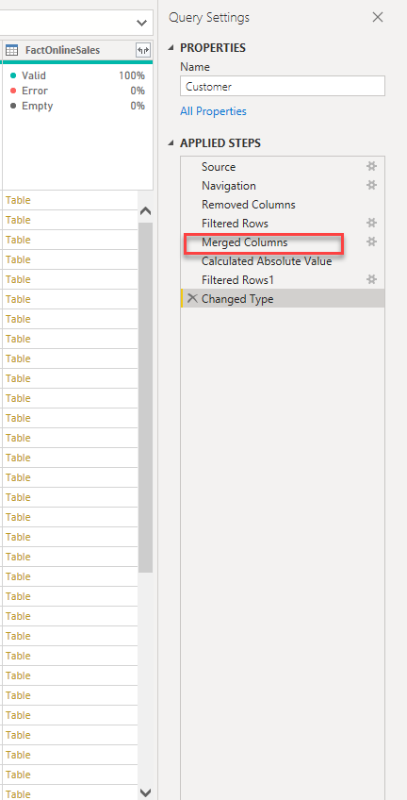
Query Folding – why should I care?
Data refresh more efficient
With DirectQuery/Dual the query must fold!
Incremental refresh
ALL or NOTHING?
Slow report
Slow visuals
Large data model
IT‘S NOT BECAUSE OF QUERY (NON)FOLDING!!!
@DataMozart

Slide 10
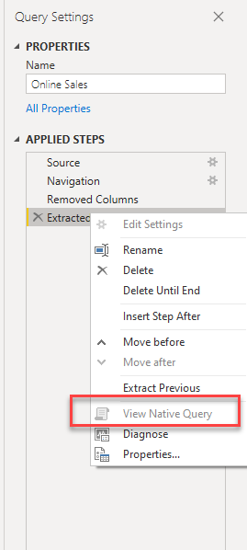
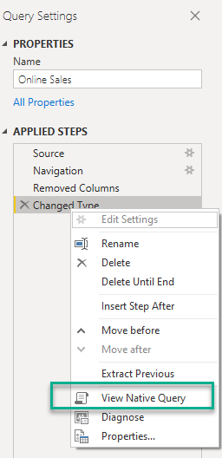
How do you know if the query folds?
View Native Query
It’s not 100% correct!!!
Use Query Diagnostics in PQ Editor or SQL Server Profiler
New feature in Power Query Online!
PROBABLY!!!
@DataMozart

Slide 11

Devil is in the details!
Little nuances can make a big difference!
DEMO TIME!
@DataMozart

Slide 12
Devil #1 – Merge Join
@DataMozart

Slide 13
Devil #2 – Change Data Type
@DataMozart

Slide 14
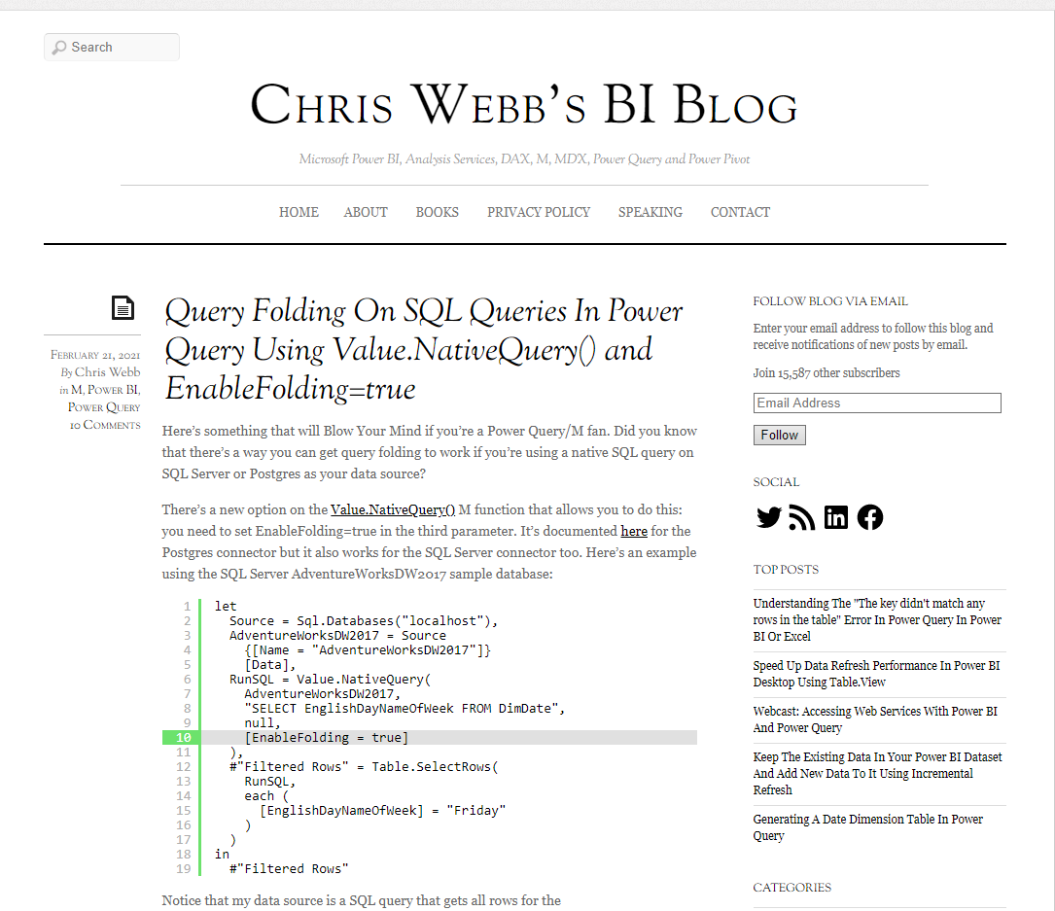
Devil #3 – Native SQL query
@DataMozart

Slide 15
Devil #4 – When View Native Query lies…
@DataMozart

Slide 16
Query folding – why should I care? Part 2
@DataMozart

Slide 17

Where to go from here?
30 days of Query folding challenge from Alex Powers
https://www.youtube.com/watch?v=9sV3hIn8VTY
Chris Webb’s blog
https://blog.crossjoin.co.uk
Microsoft official documentation
https://docs.microsoft.com/en-us/power-bi/guidance/power-query-folding
@DataMozart

Slide 18




Thank you!
Data-mozart.com
Nikola Ilic
@DataMozart
@DataMozart

